Slide 1
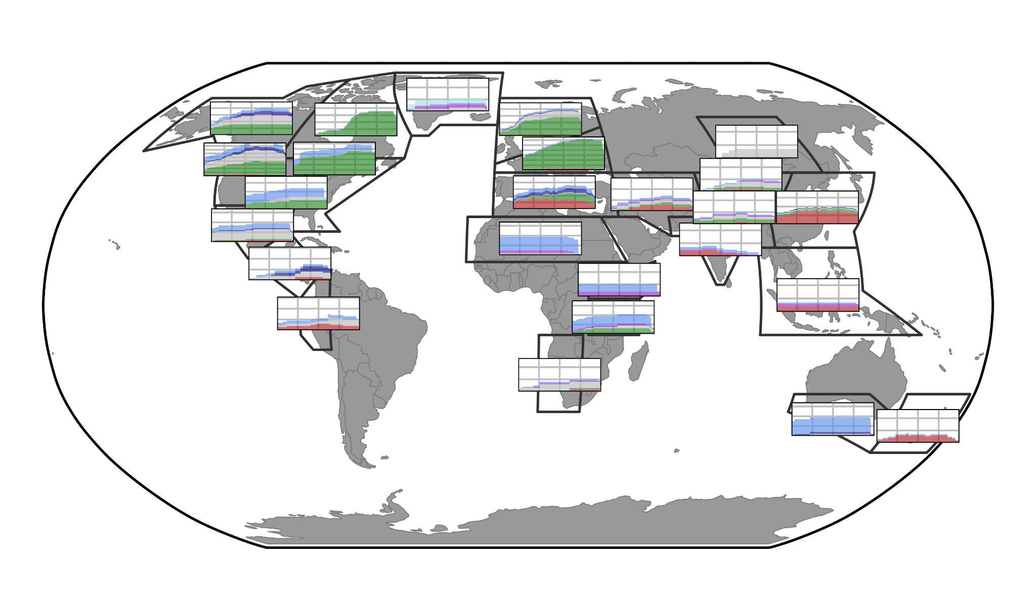
Proxy data by region

Slide 2
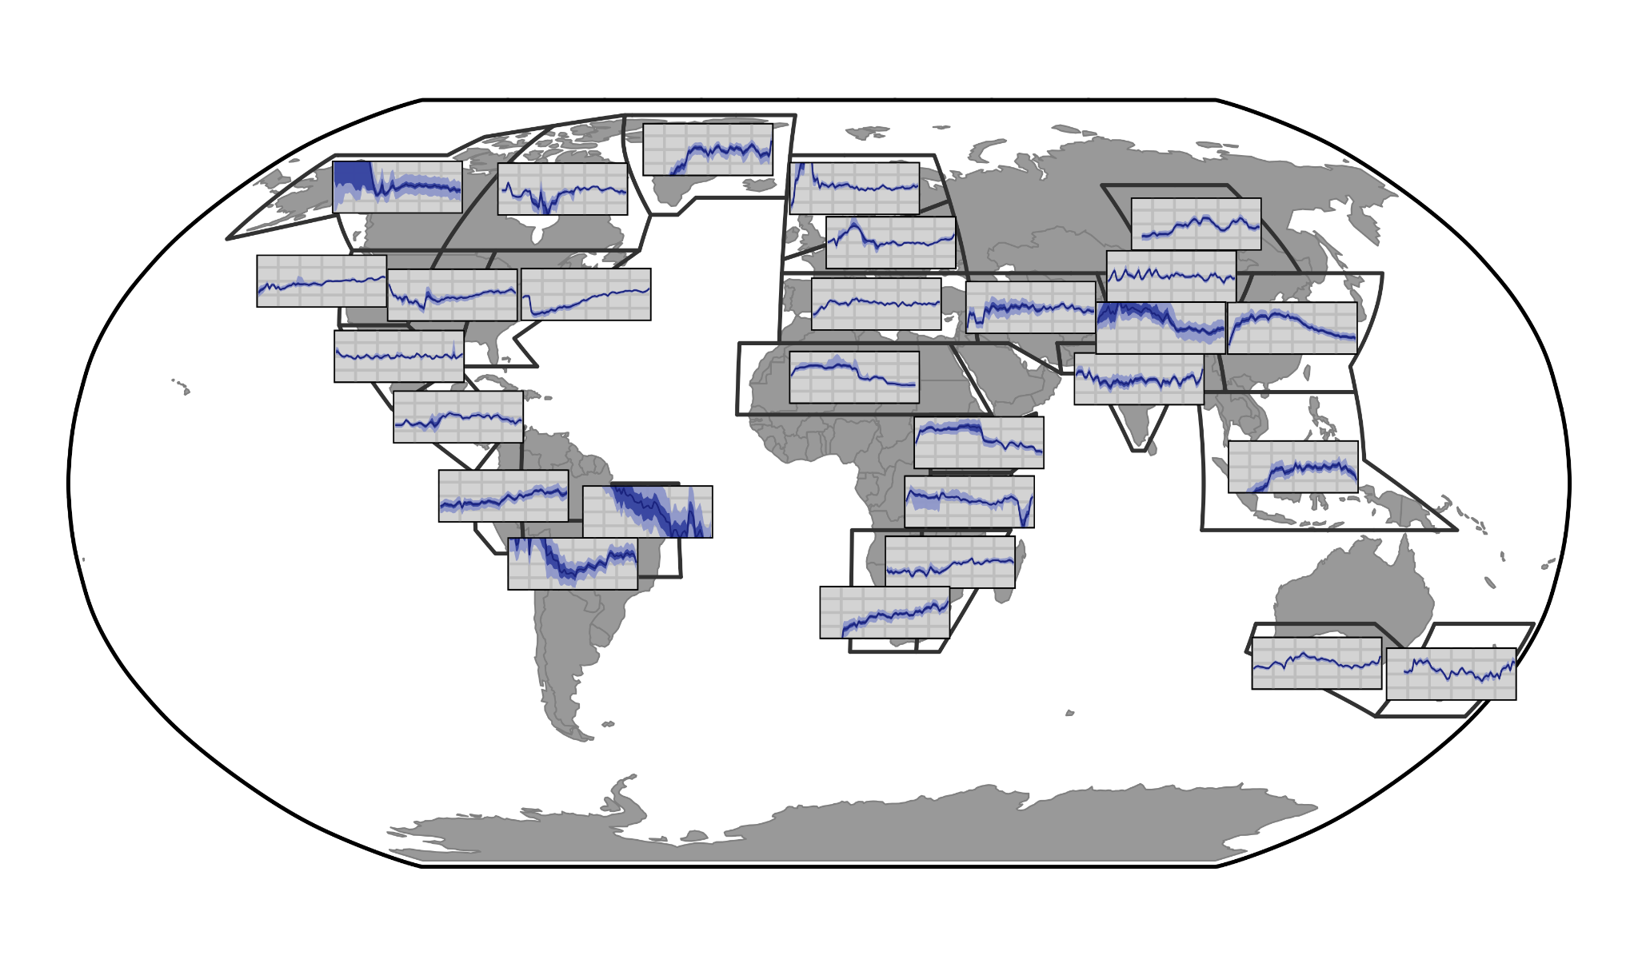

Slide 3
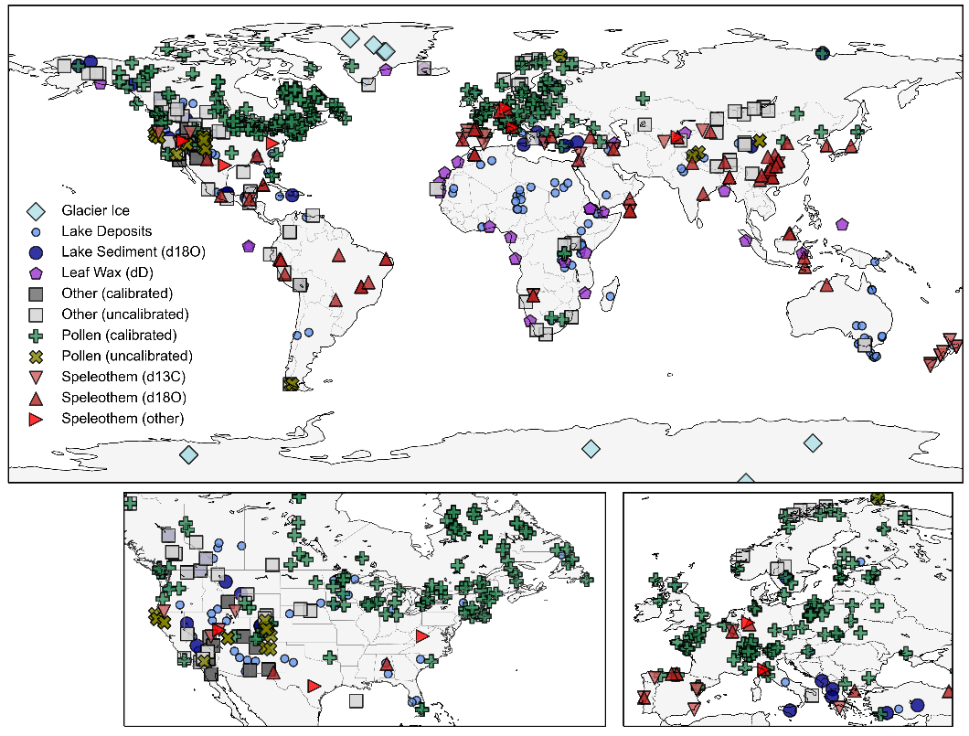

Slide 4
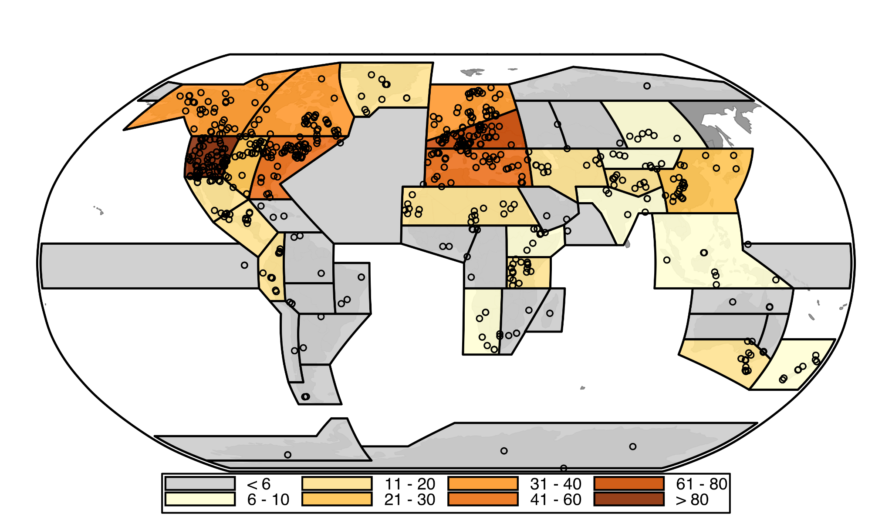
Number of proxy records within each IPCC region

Slide 5
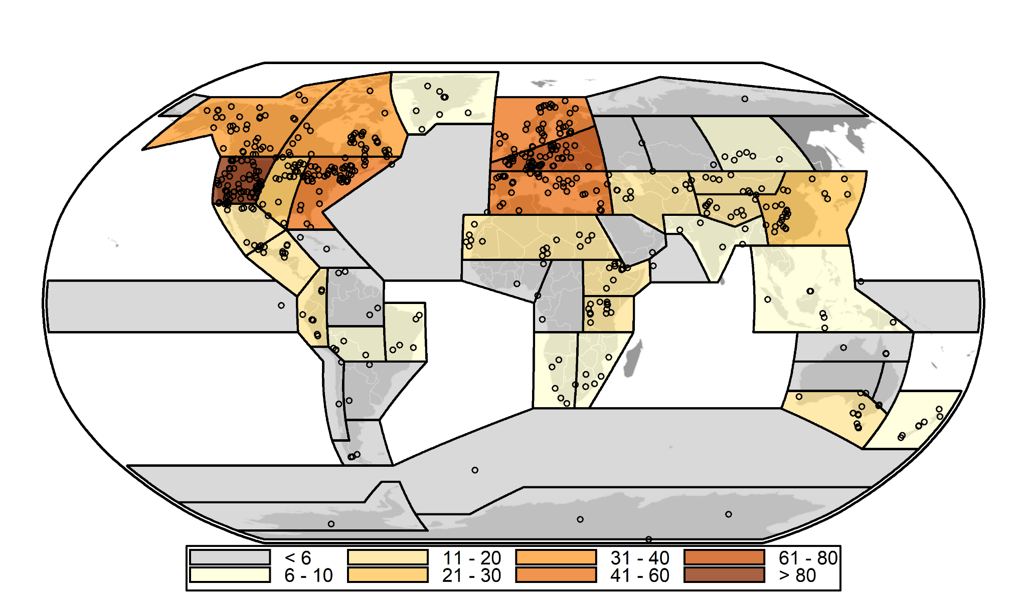

Slide 6
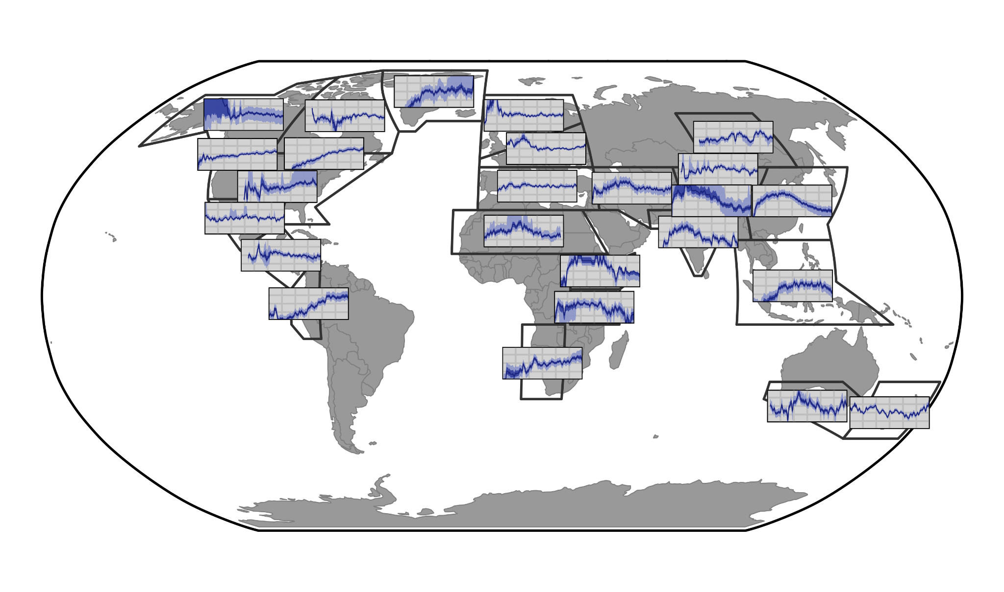
Proxy composites reconstructions

Slide 7
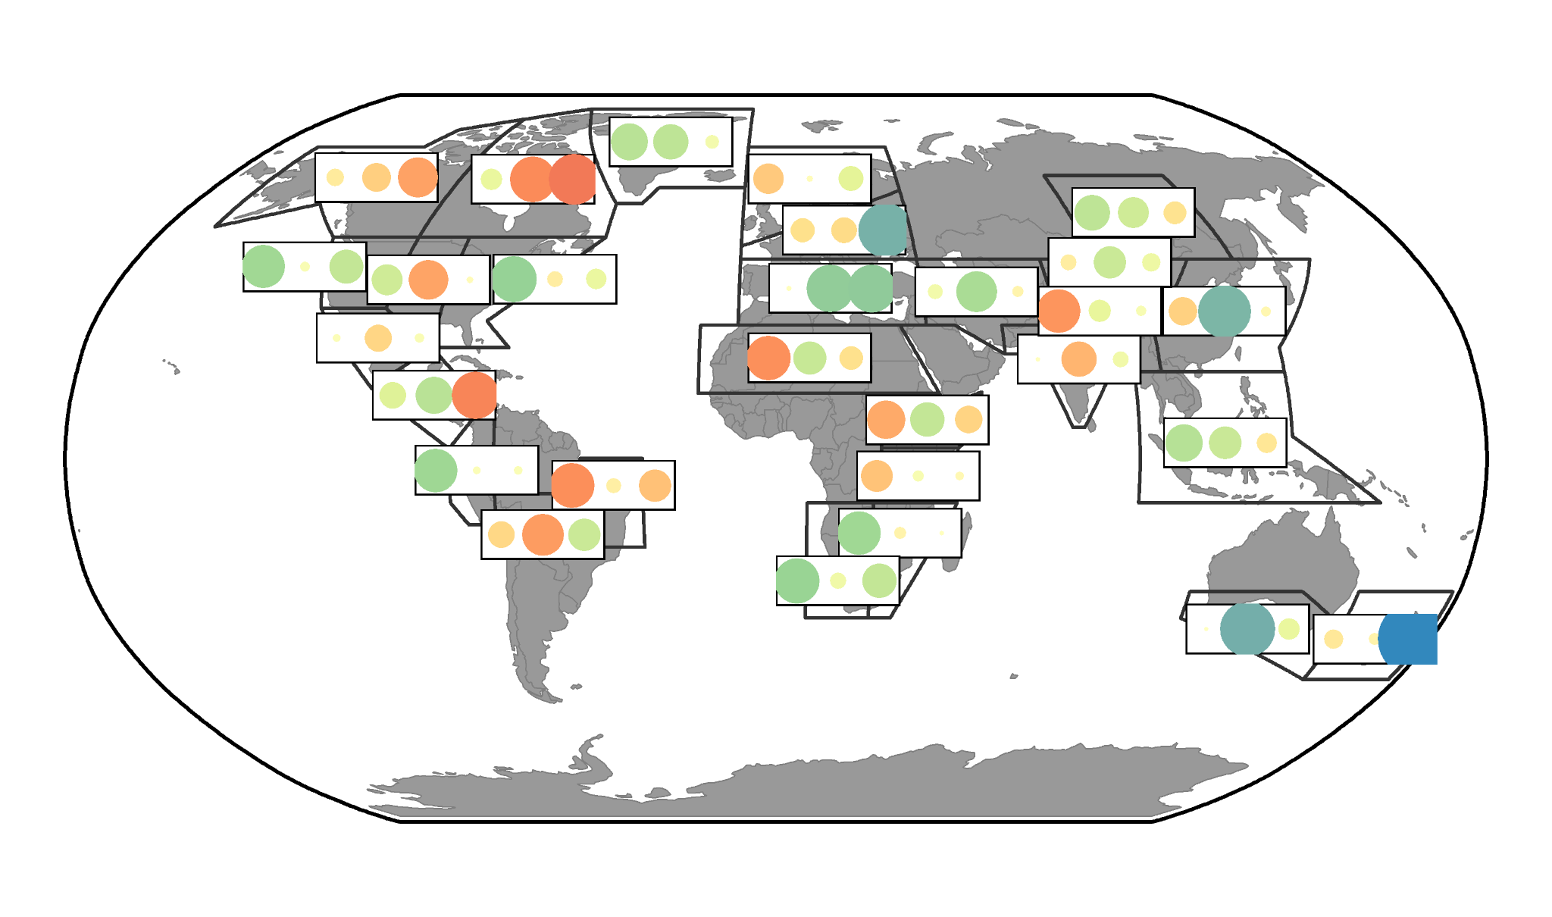

Slide 8
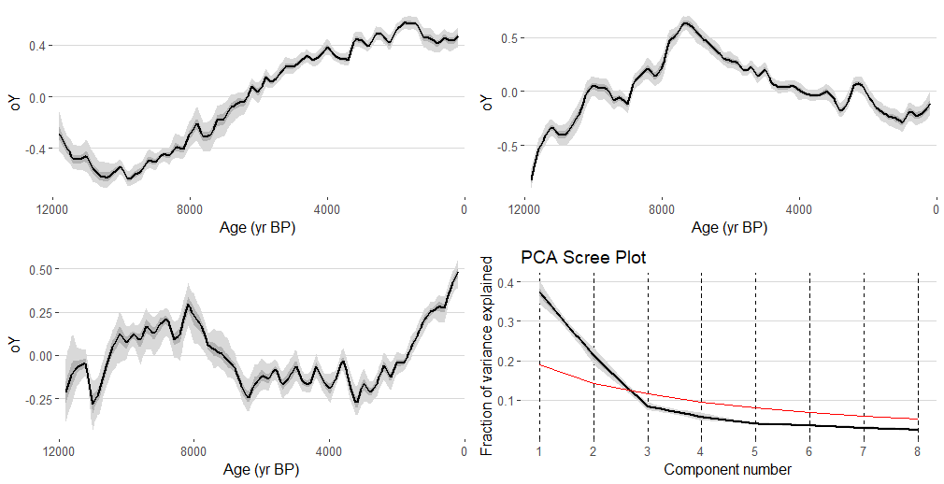
PC2
PC1
PC3

Slide 9
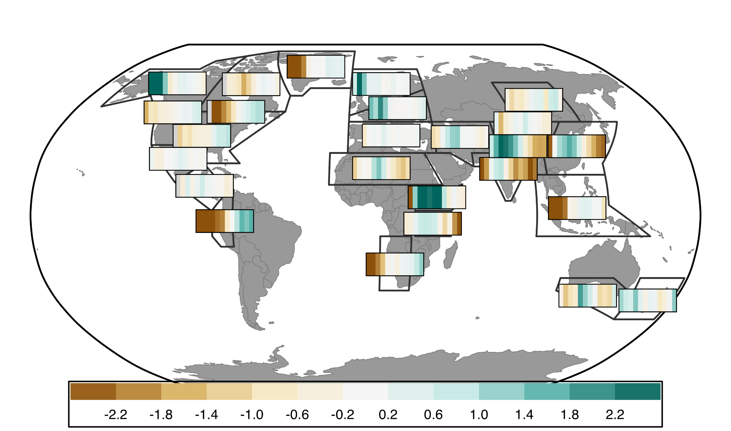
Regional Patterns in Millennial Scale Trends of Holocene Hydroclimate

Slide 10
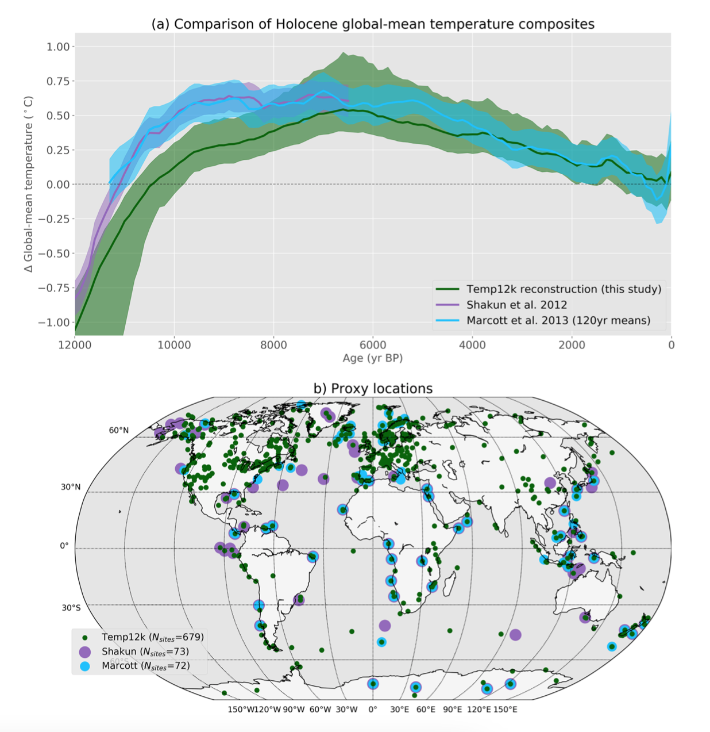
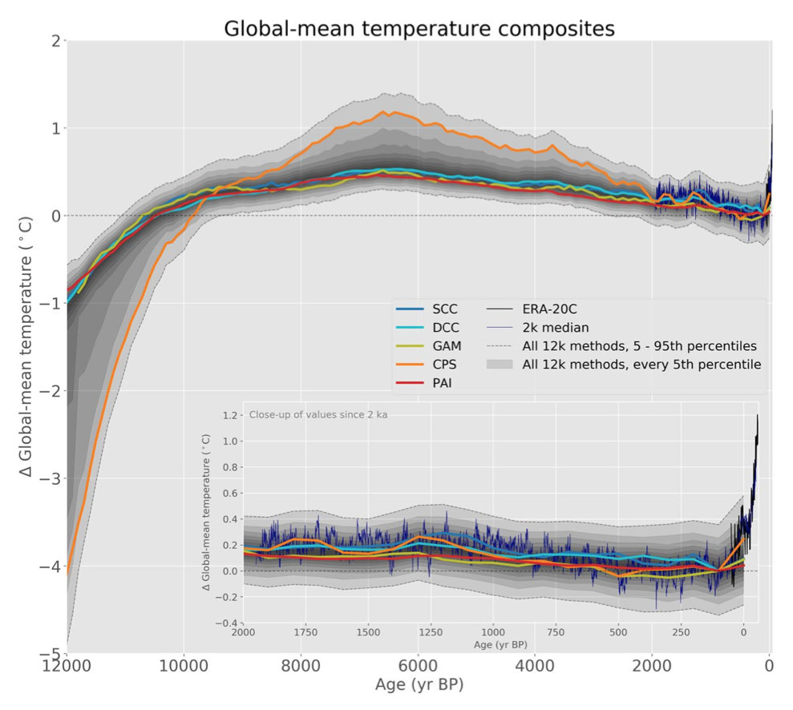
Hydroclimate research follows Temp12k

Slide 11
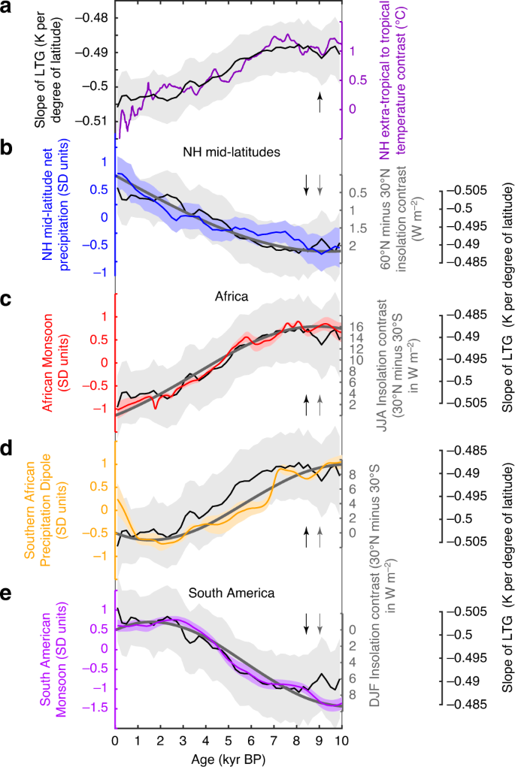
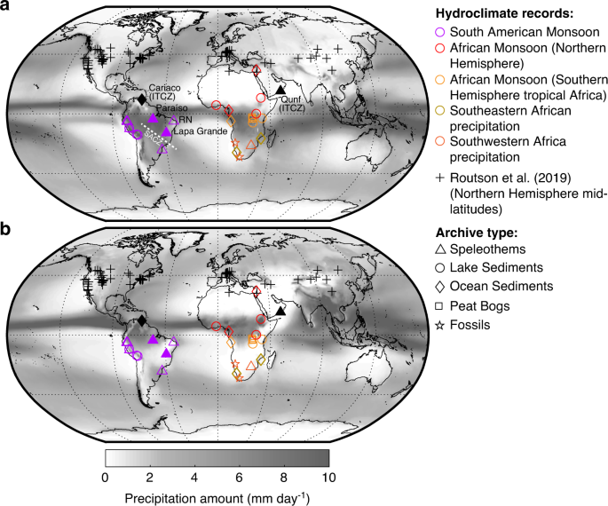
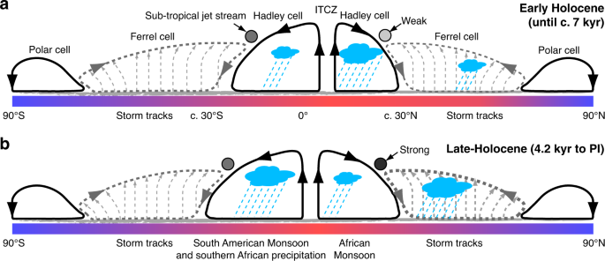
Few global multi-proxy hydroclimate reconstructions are

Slide 12
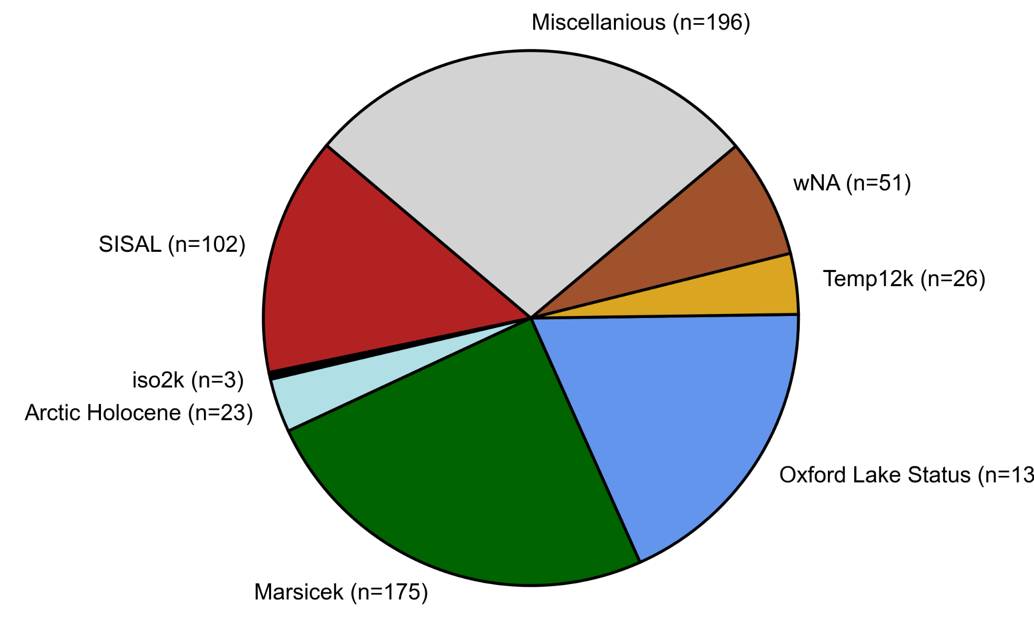
Initial work: compile a hydroclimate (P and P-E) sensitive dataset
Also Routson et al. 2018 (MidLats) can’t find info on QC sheet to search by

Slide 13
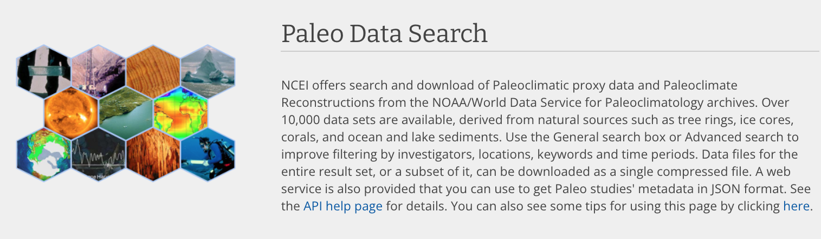


Searched public repositories for individual records
as well as previous data compilations

Slide 14


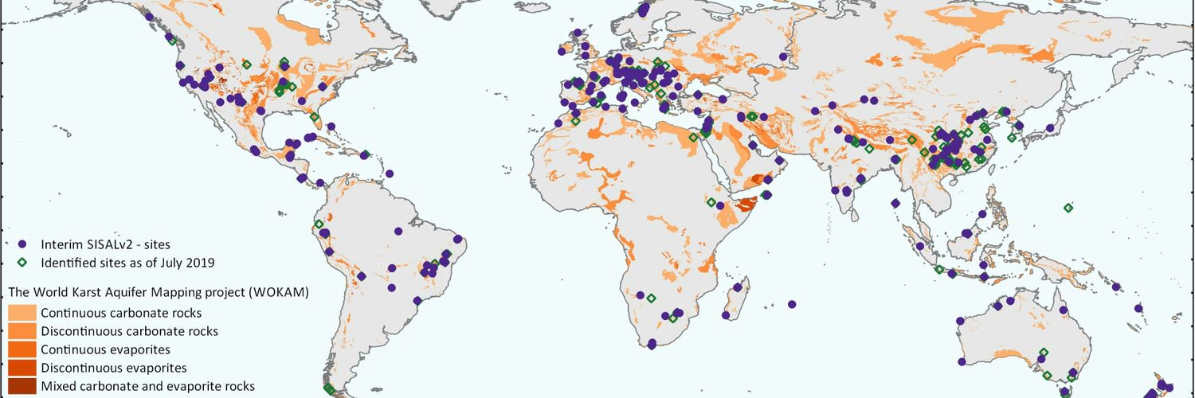
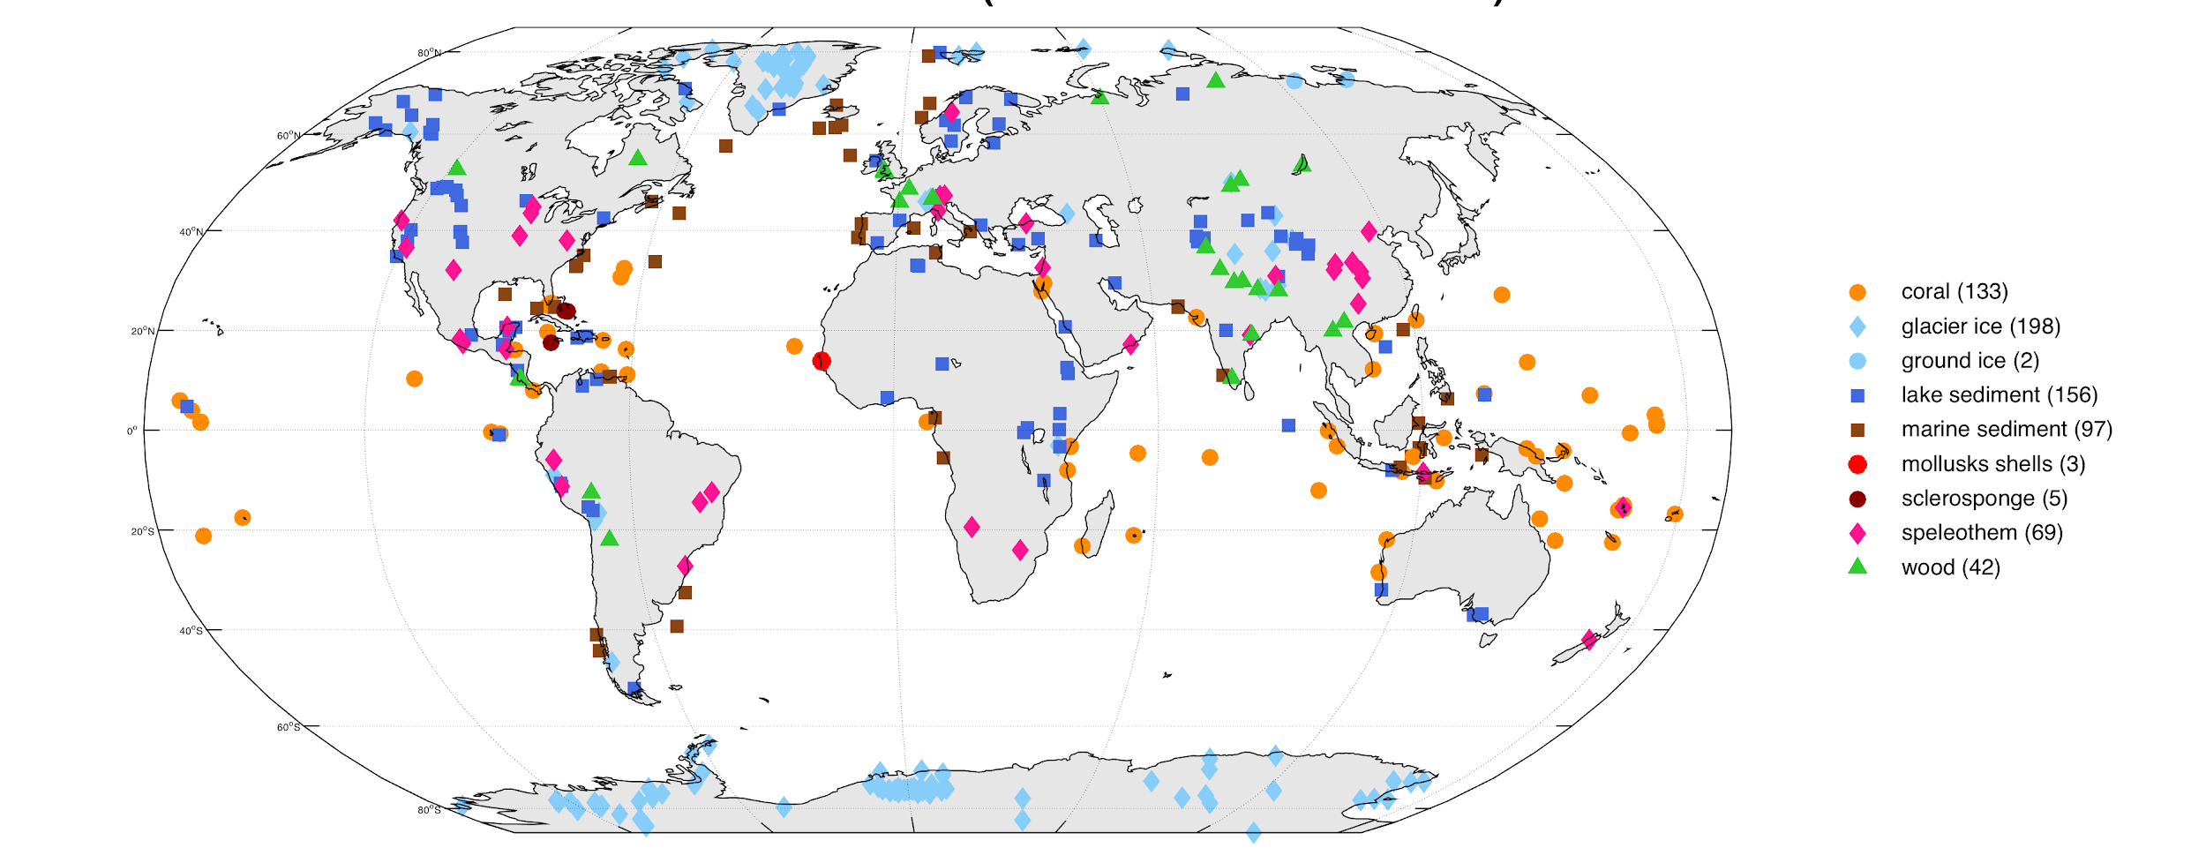
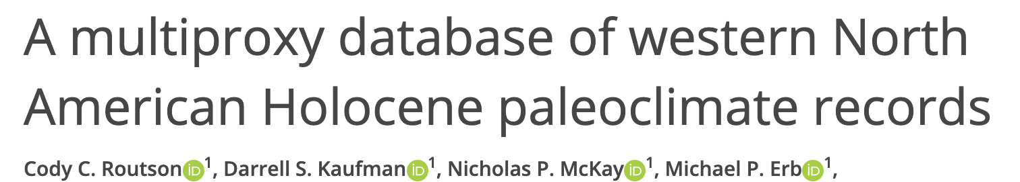
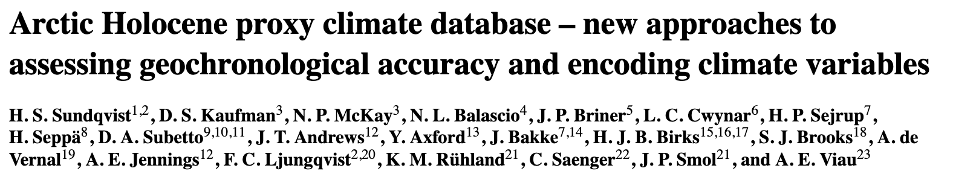
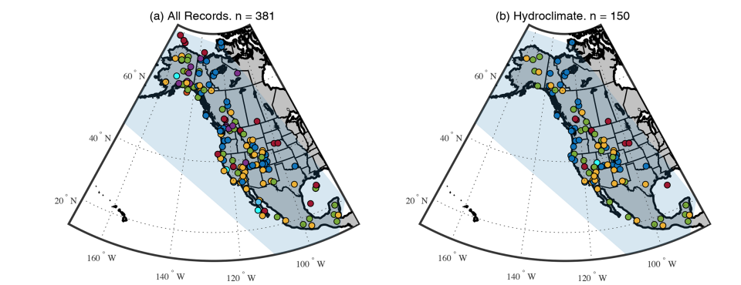
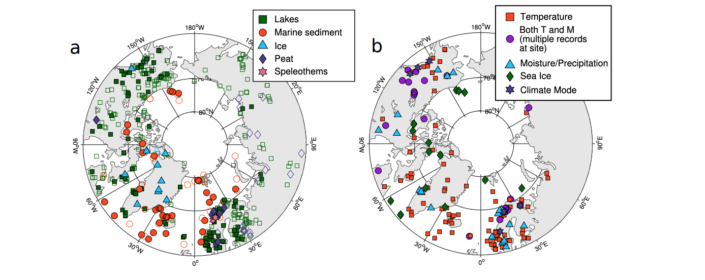

Slide 15
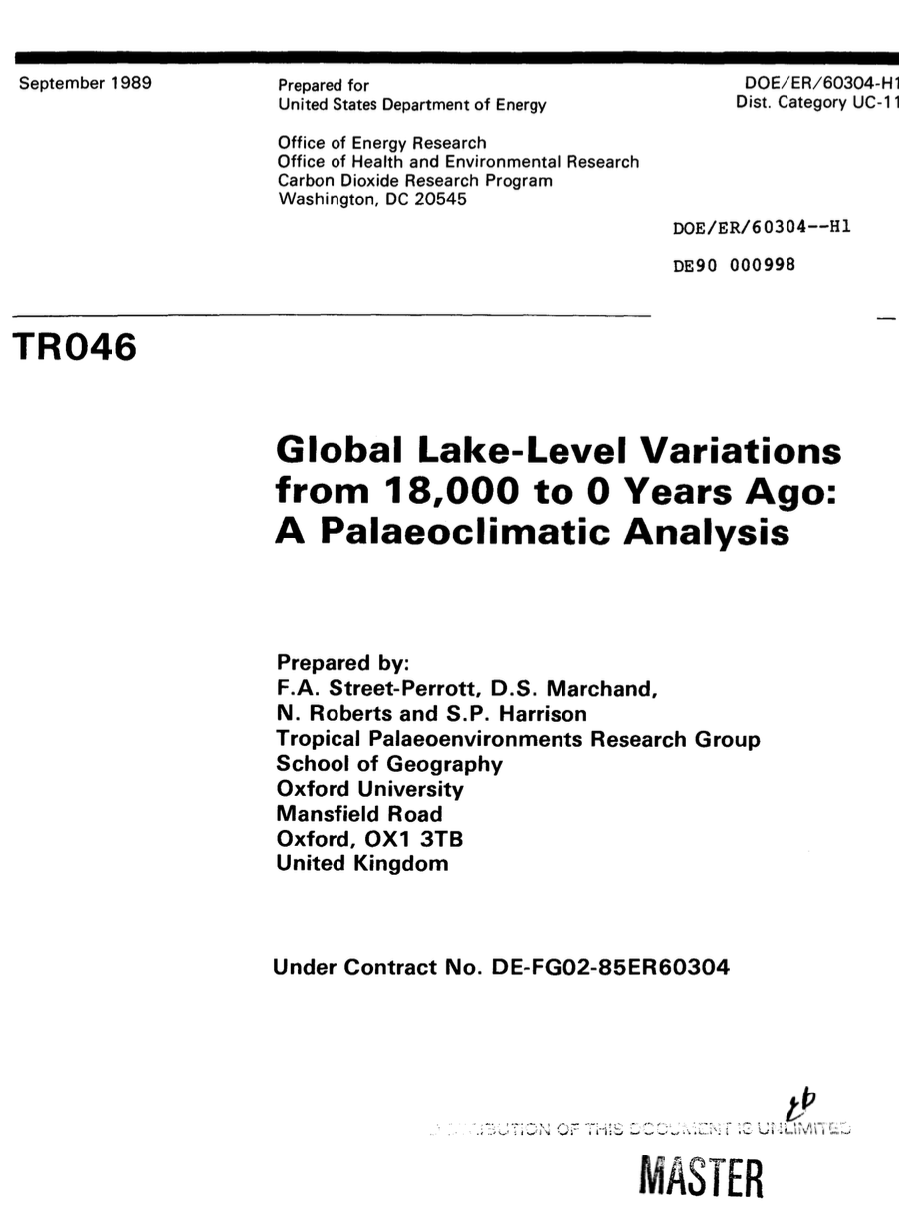
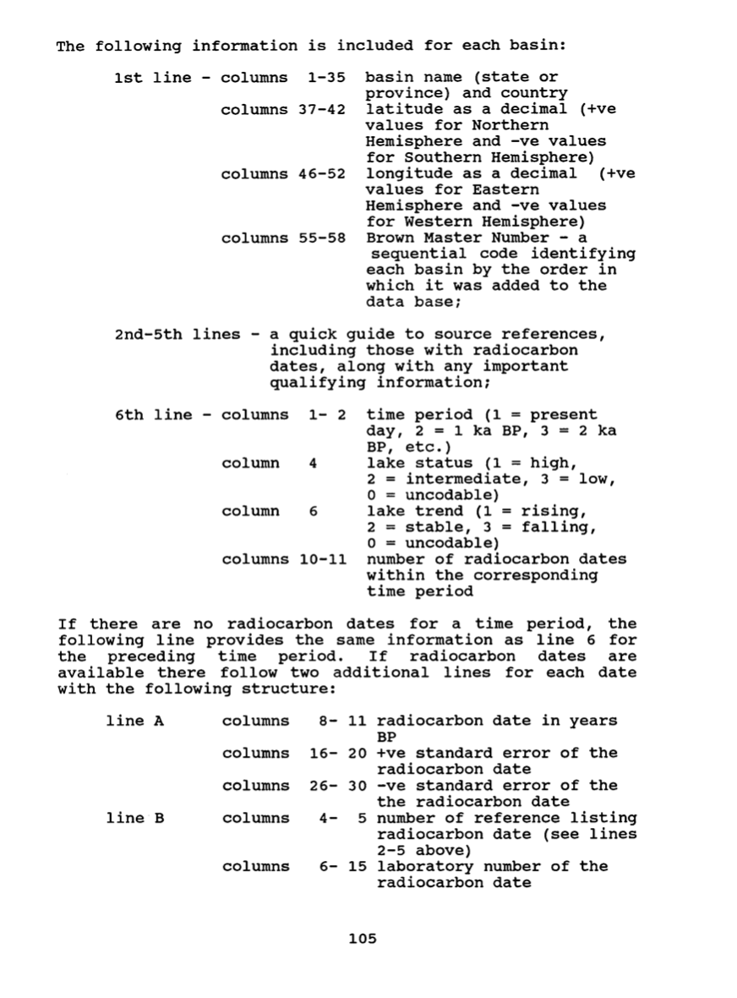
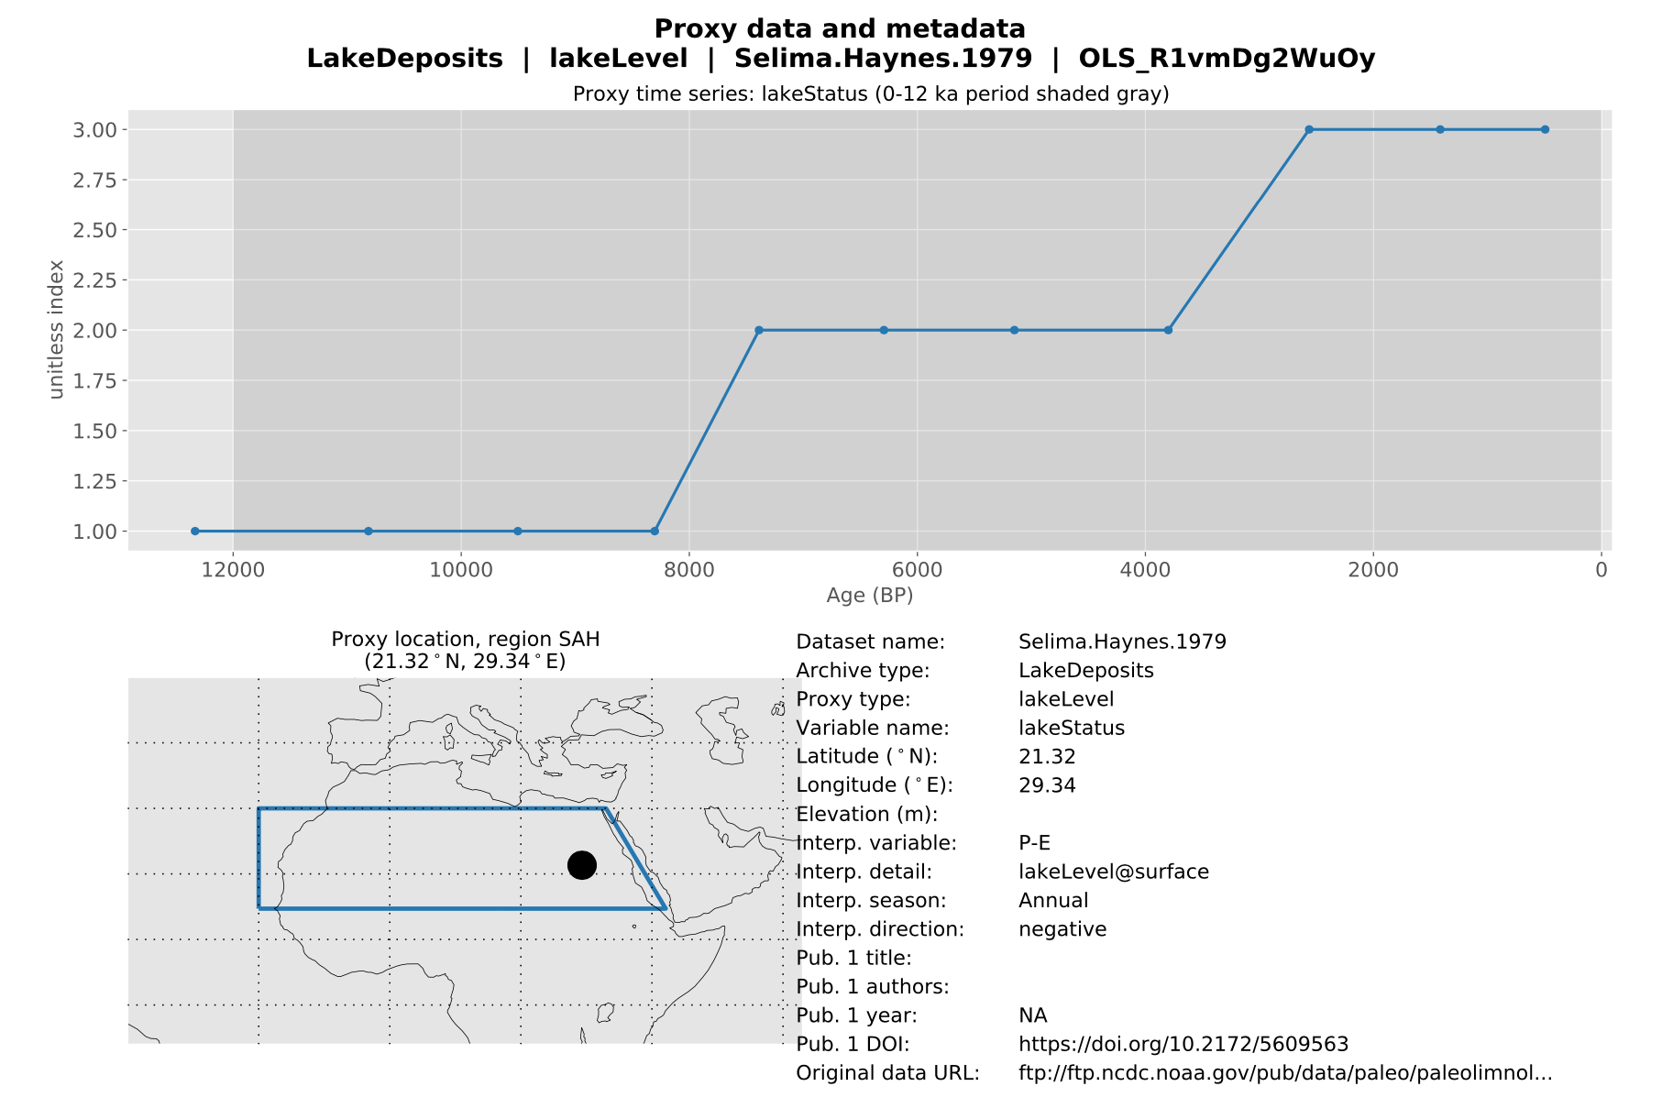

Slide 16

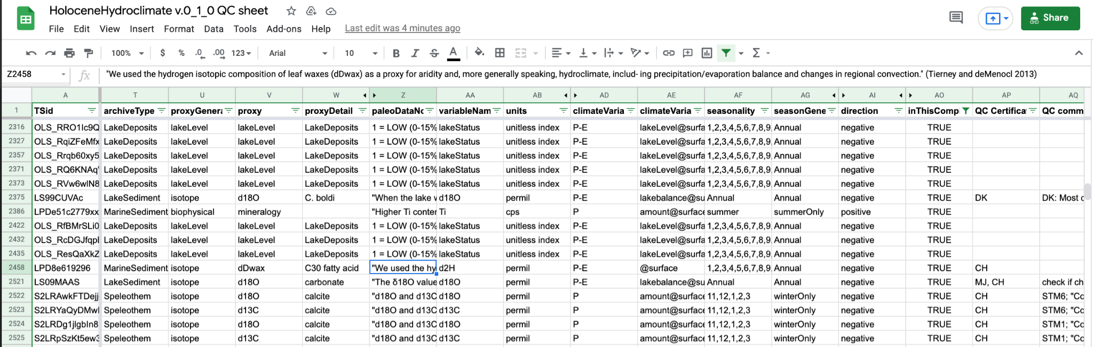
Data Management: Convert to LiPD format and add climate/seasonality metadata based on original author interpretations

Slide 17
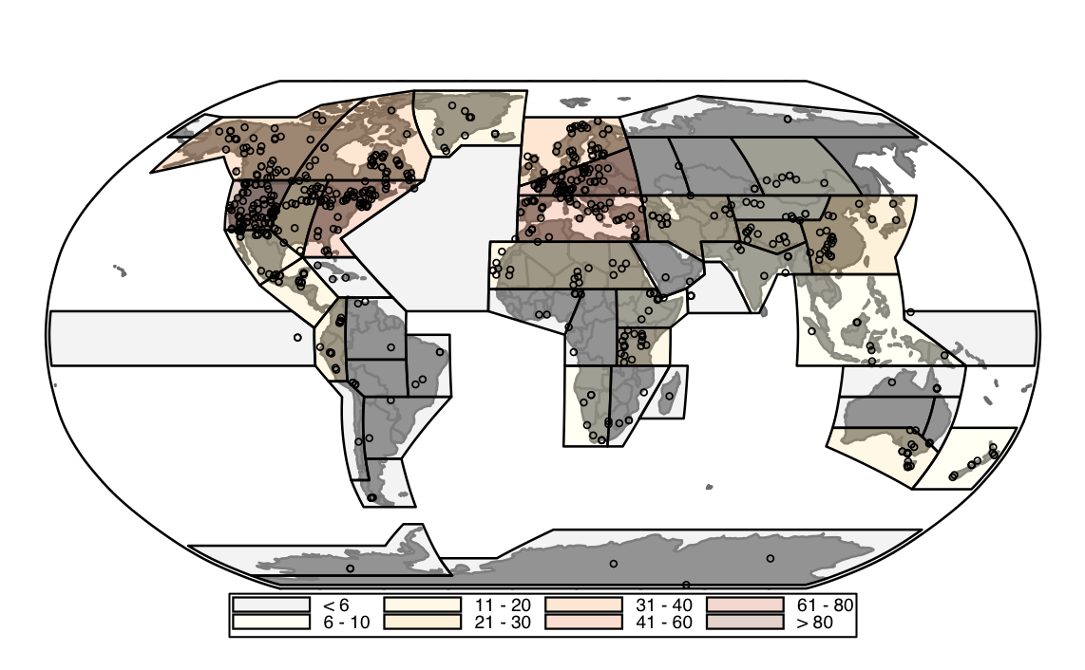

Slide 18
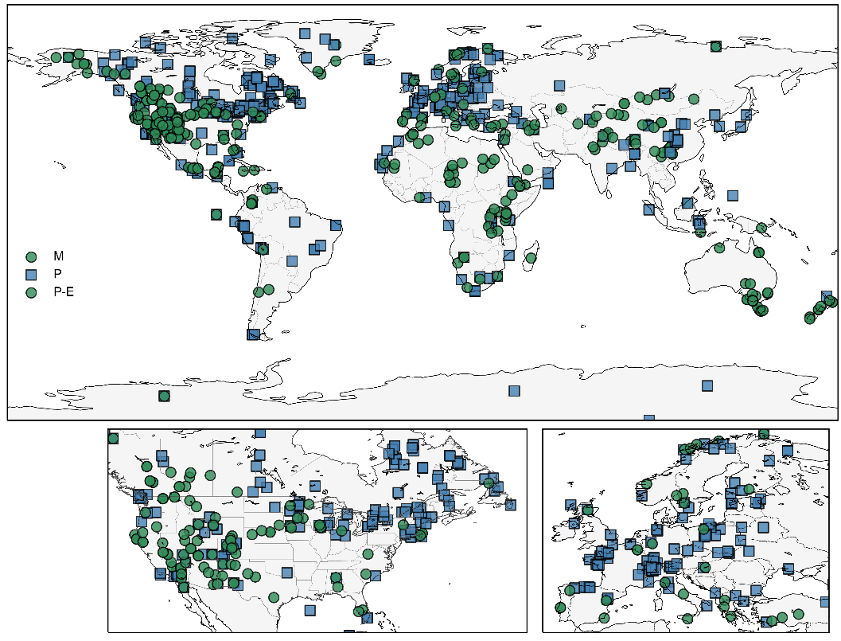

Slide 19
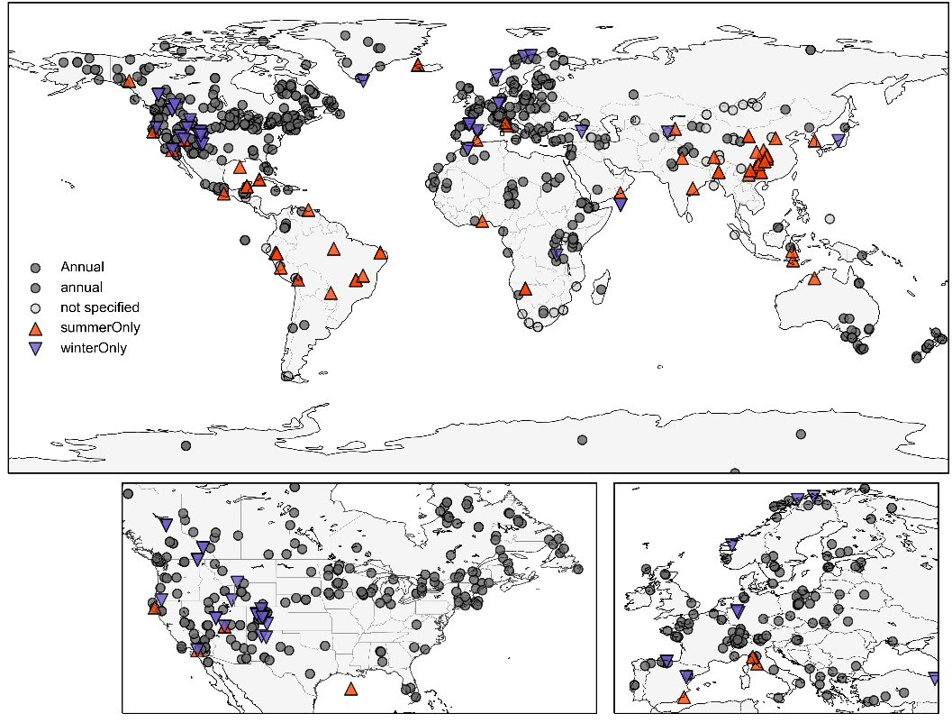

Slide 20
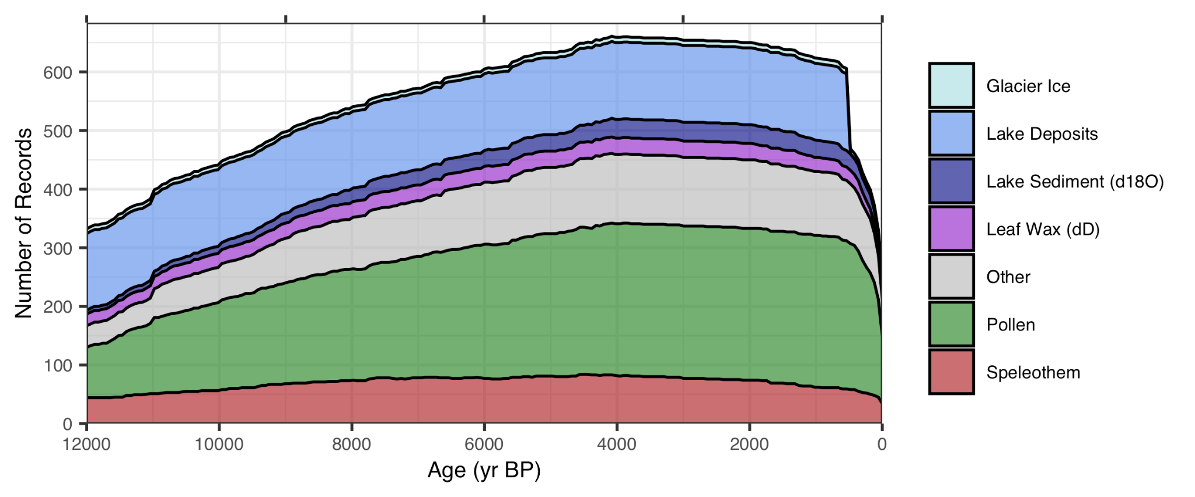
Number of Records over time

Slide 21
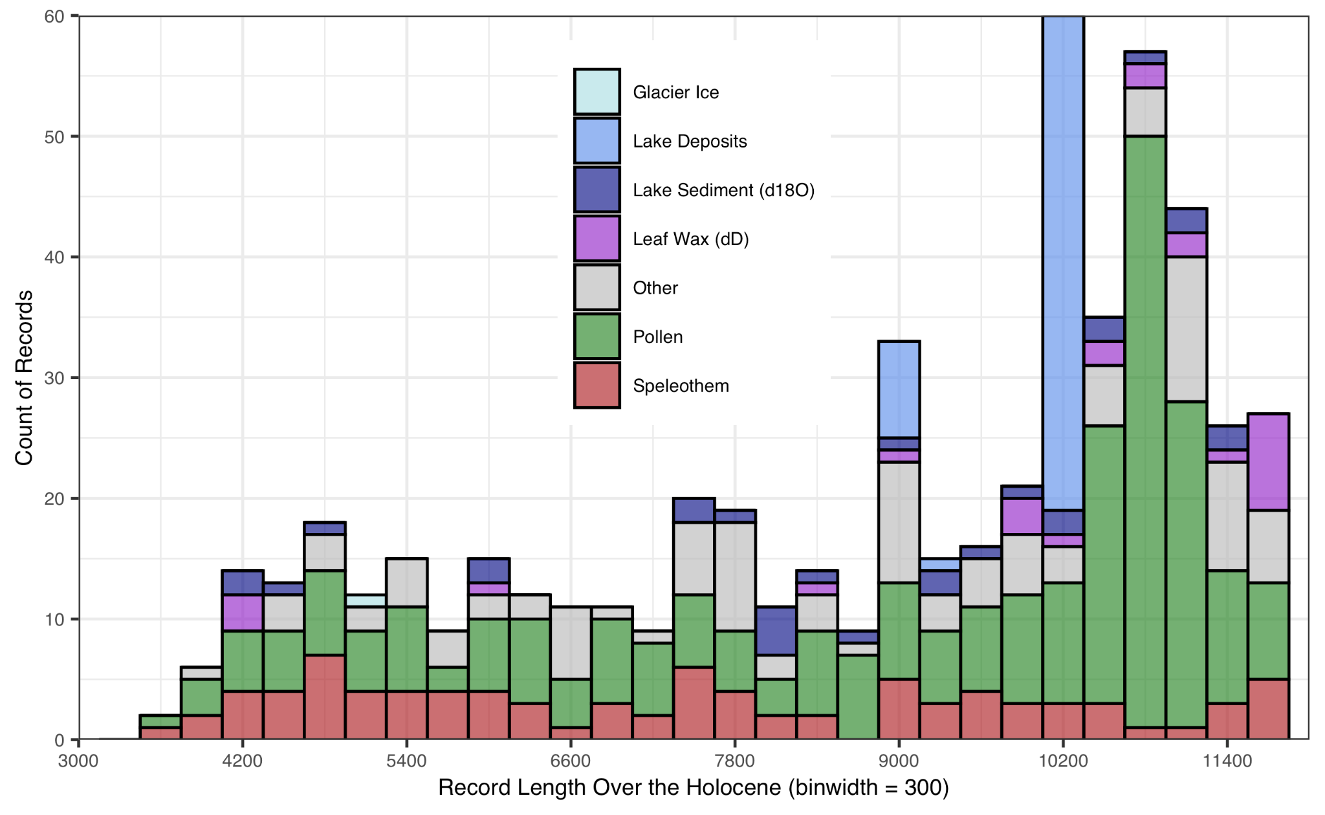
Histogram of record length
(median=10,300
mean=9,200)

Slide 22
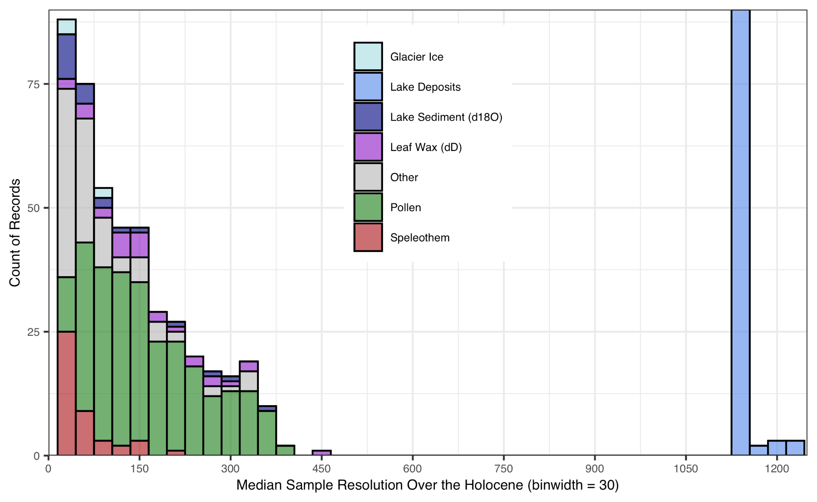
Histogram of record resolution
(median=120
mean=310)
Notes:
doesn’t count if value remains the same

Slide 23
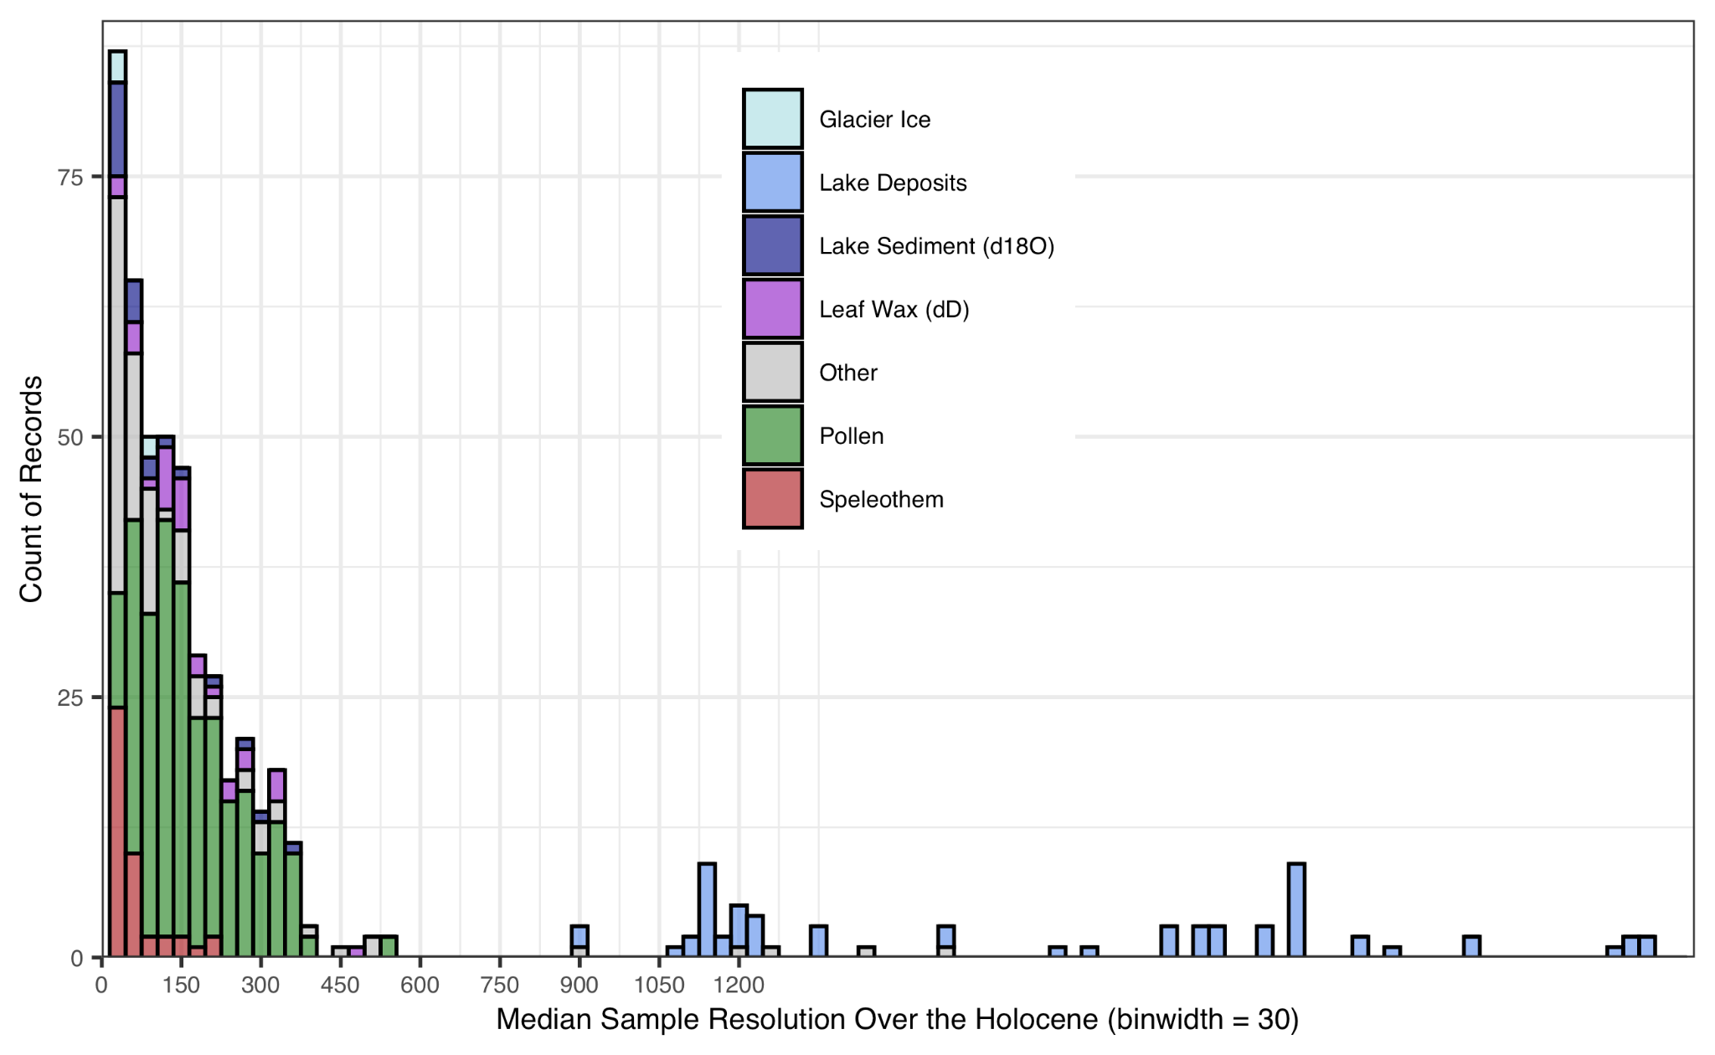
Histogram of record resolution
(median=120
mean=484)
Notes:
doesn’t count if value remains the same

Slide 24
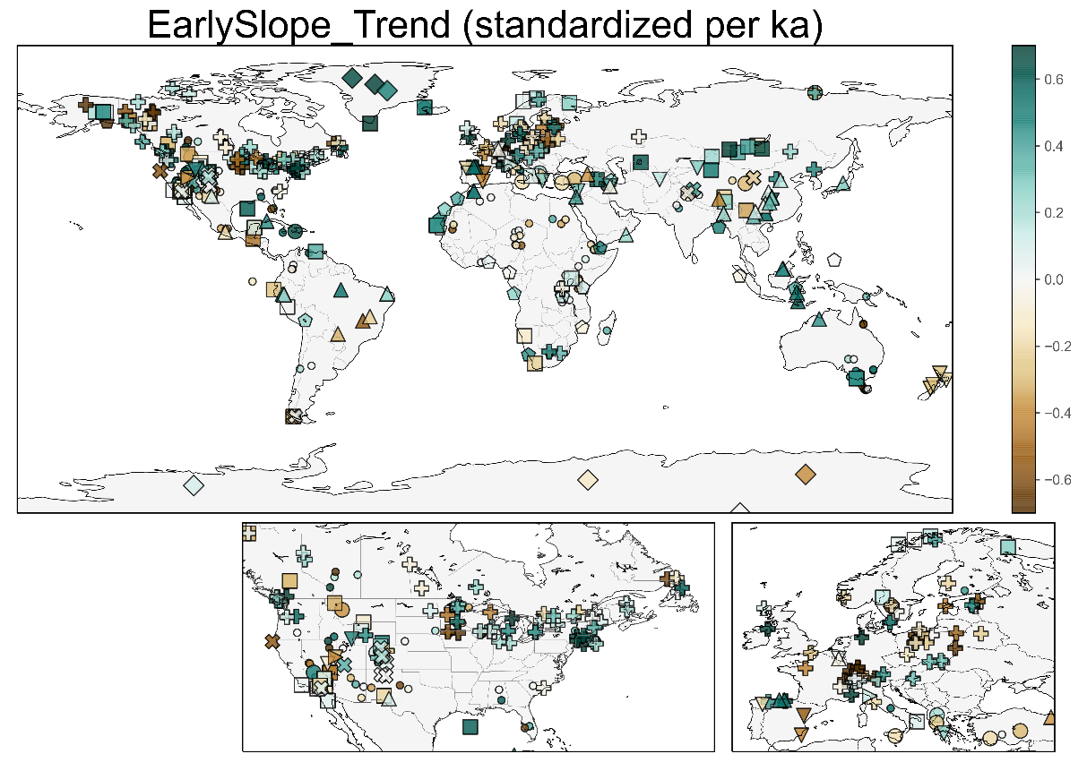

Slide 25
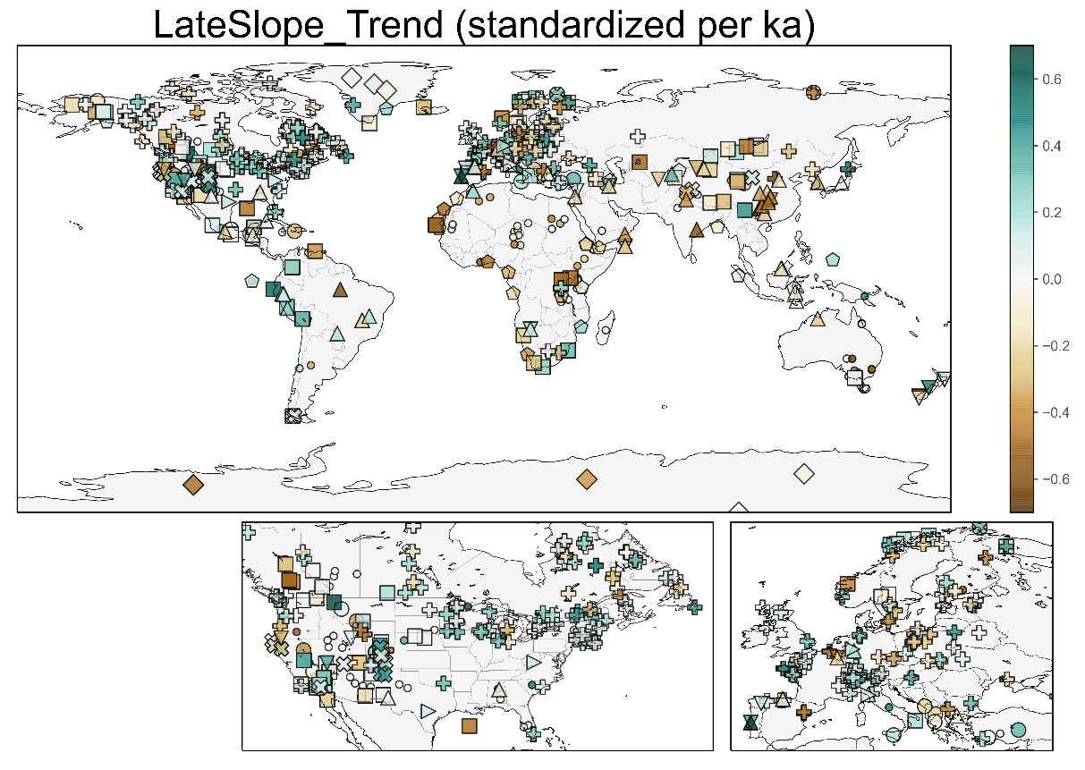

Slide 26
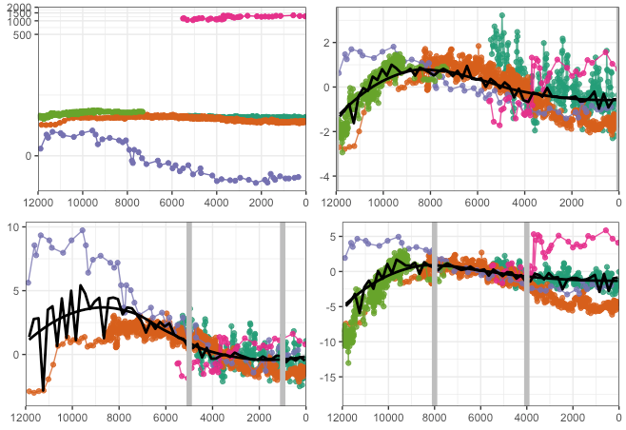
Typical composite method using z scores
Data on different values scales (precip mm/a vs d18O)
Subtract mean and divide by standard deviation

Slide 27
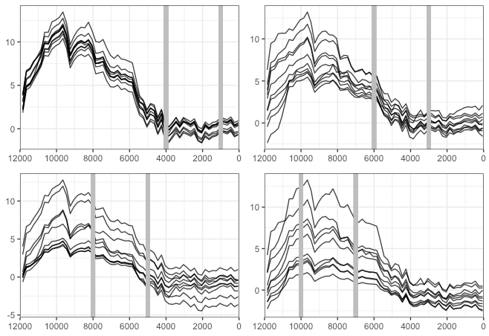
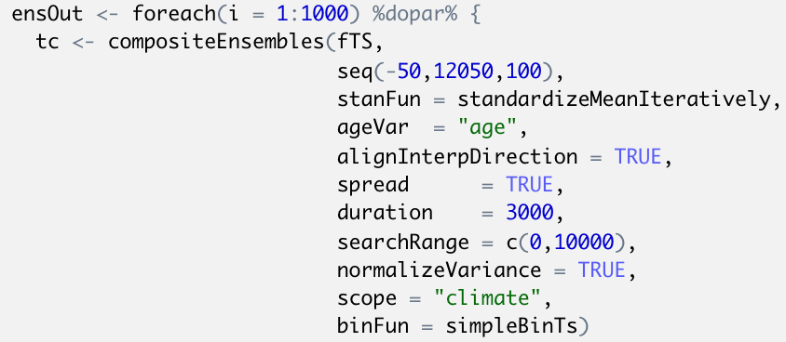
Composite R Code

Slide 28
2 Primary Modes of Variability?

Slide 29
abs(PCA1) loading > 0.14. 2 groups

Slide 30
max(abs(PCA1,PCA2)) loading > 0.14. 3 groups

Slide 31
max(abs(PCA1,PCA2,PCA3)) loading > 0.14. 4 groups

Slide 32
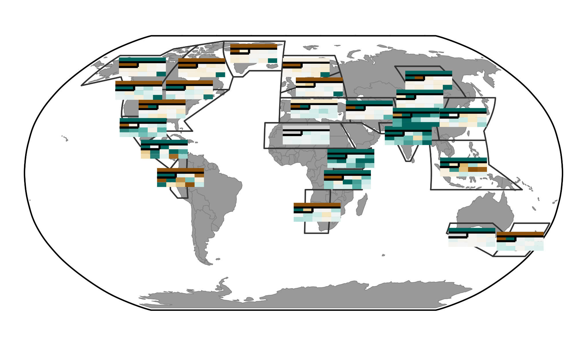
max(abs(PCA1,PCA2)) loading > 0.14. 3 groups

Slide 34
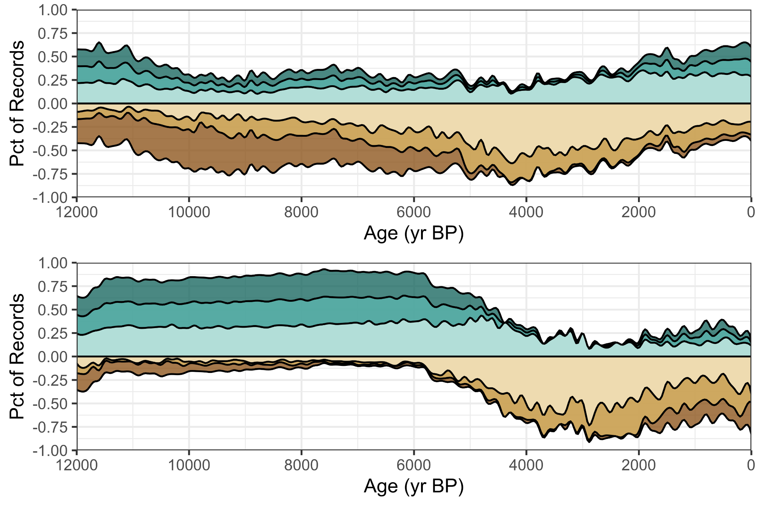
Cody figure

Slide 35
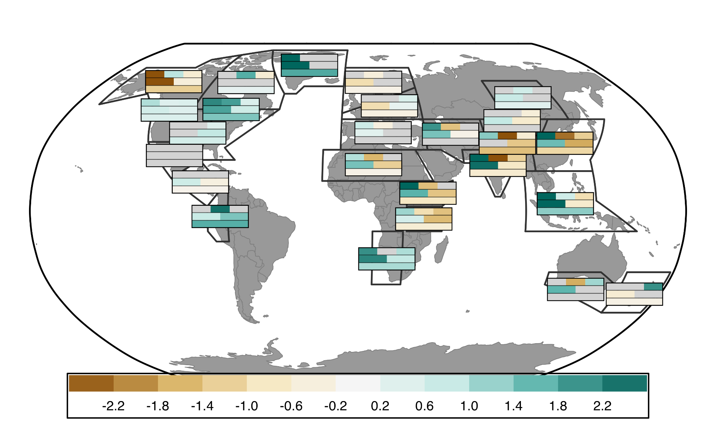
Slope of proxy composites over various time bins (full, half, third)
12-8
8-4
4-0
12-6ka
6-0ka
12-0ka

Slide 36
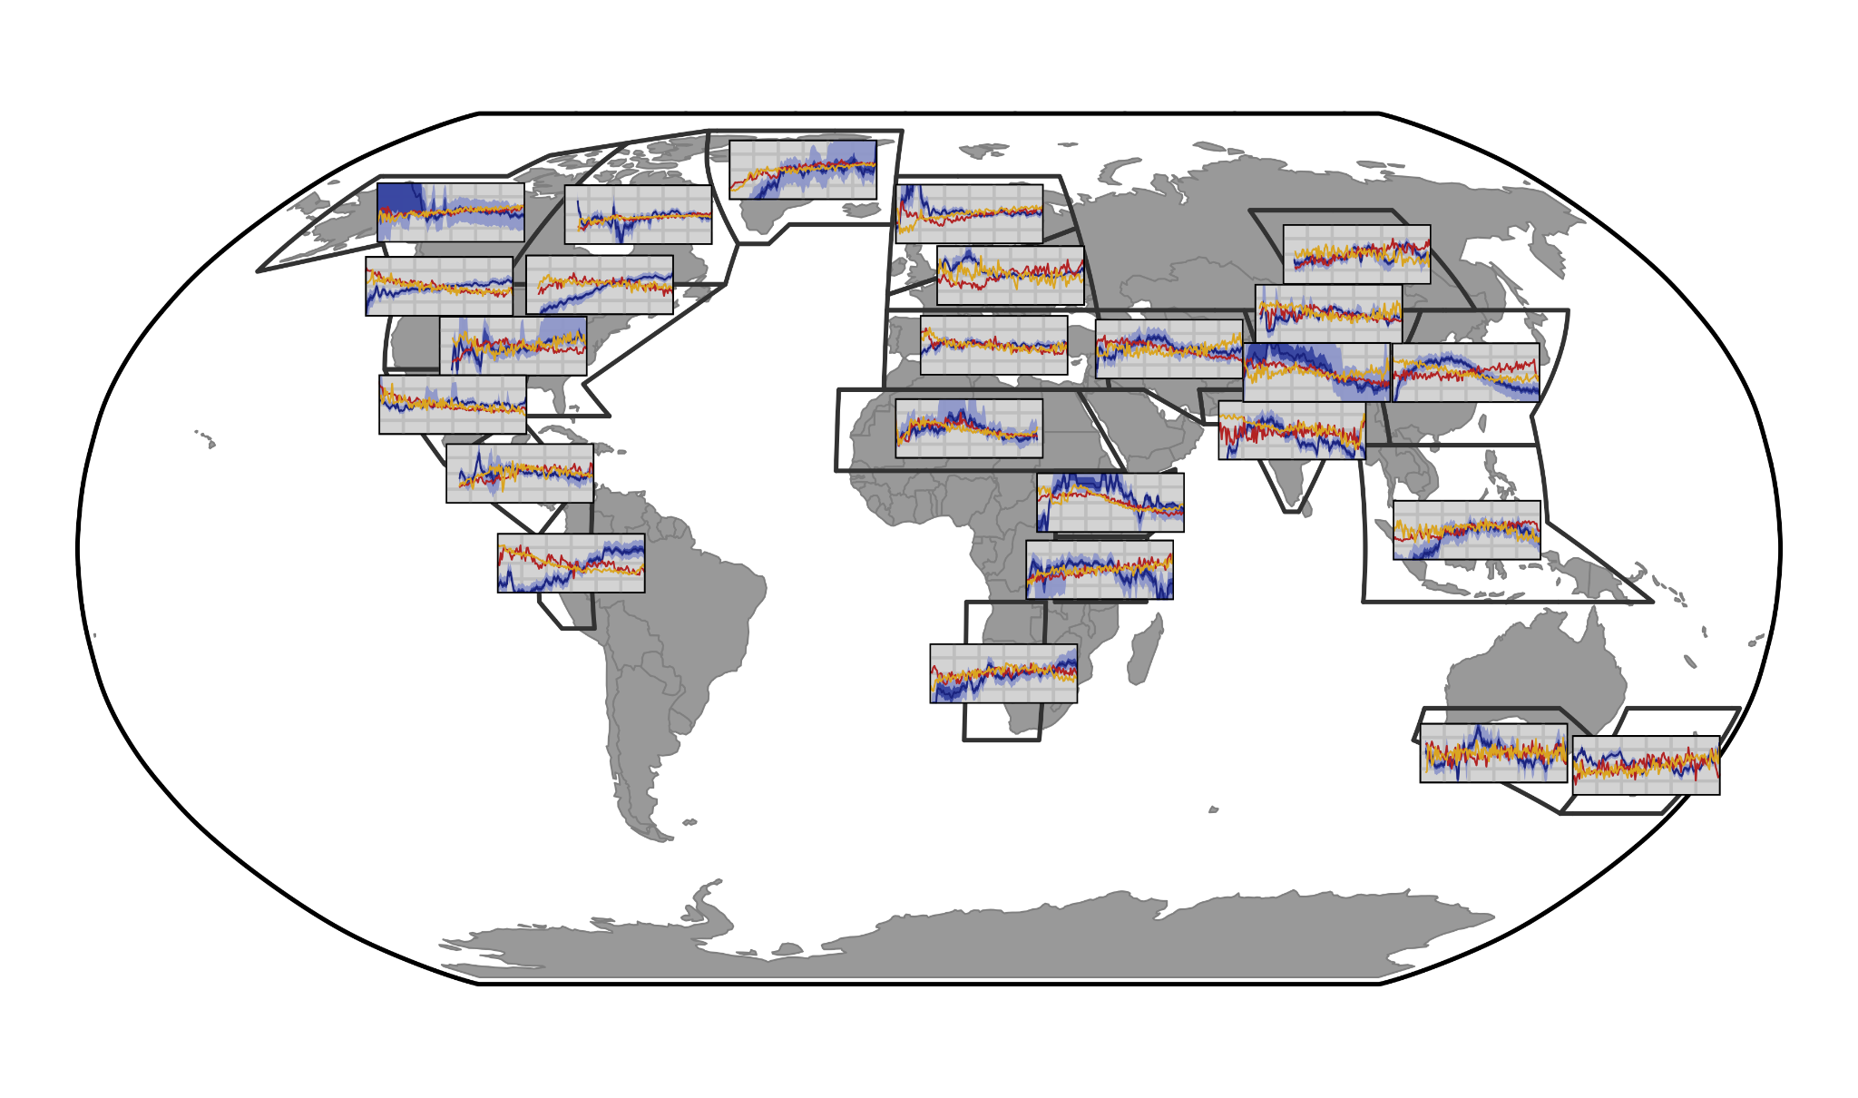
Proxy composites compared to HaCM (yellow) and TraCE (red)

Slide 37
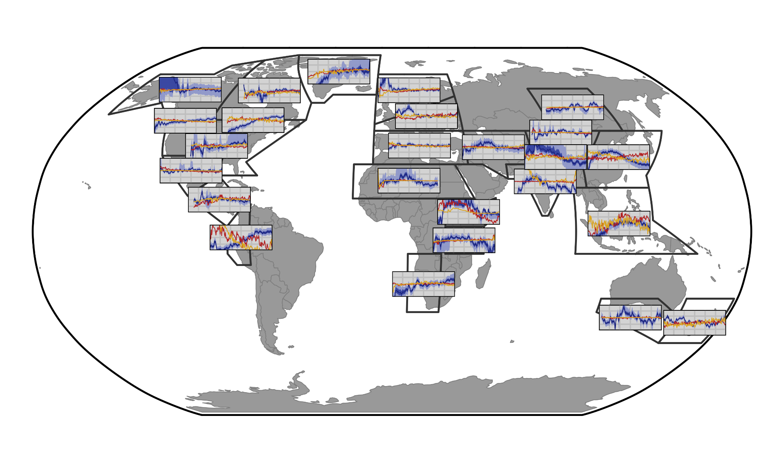
Proxy composites compared to HaCM (yellow) and TraCE (red)

Slide 38
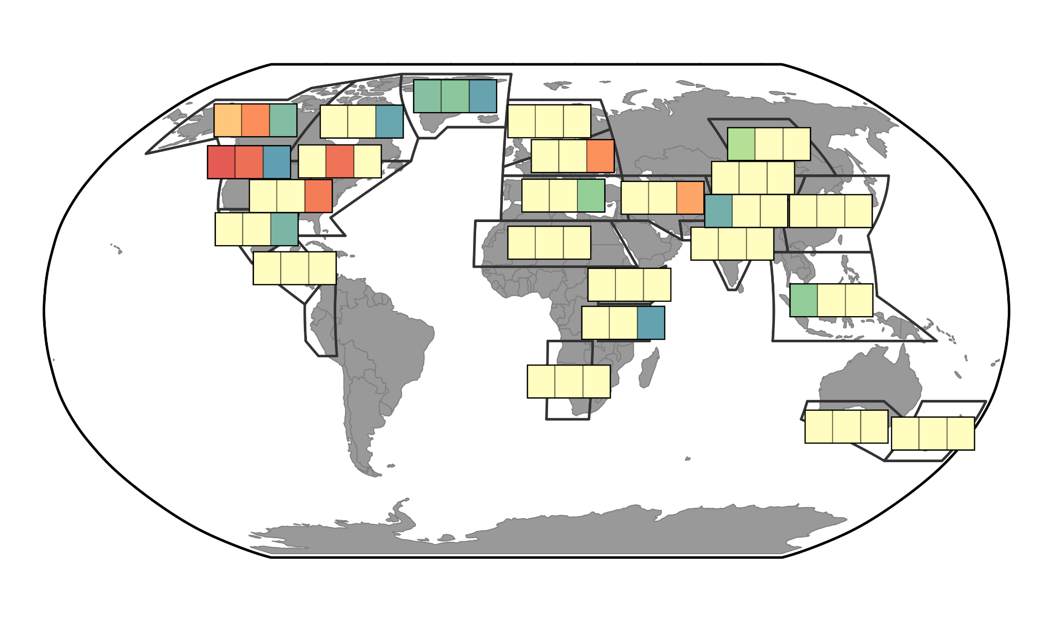
Proxy composites compared to HaCM (yellow) and TraCE (red)
P
T
P
H
H
T

Slide 39
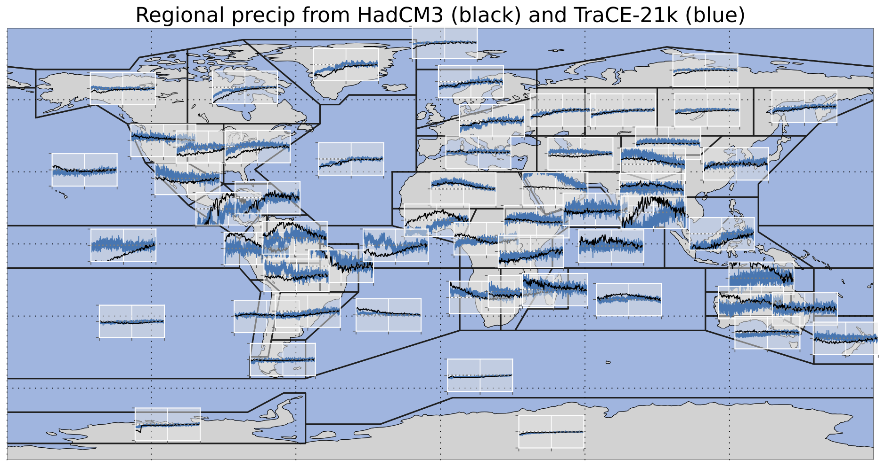

Slide 40
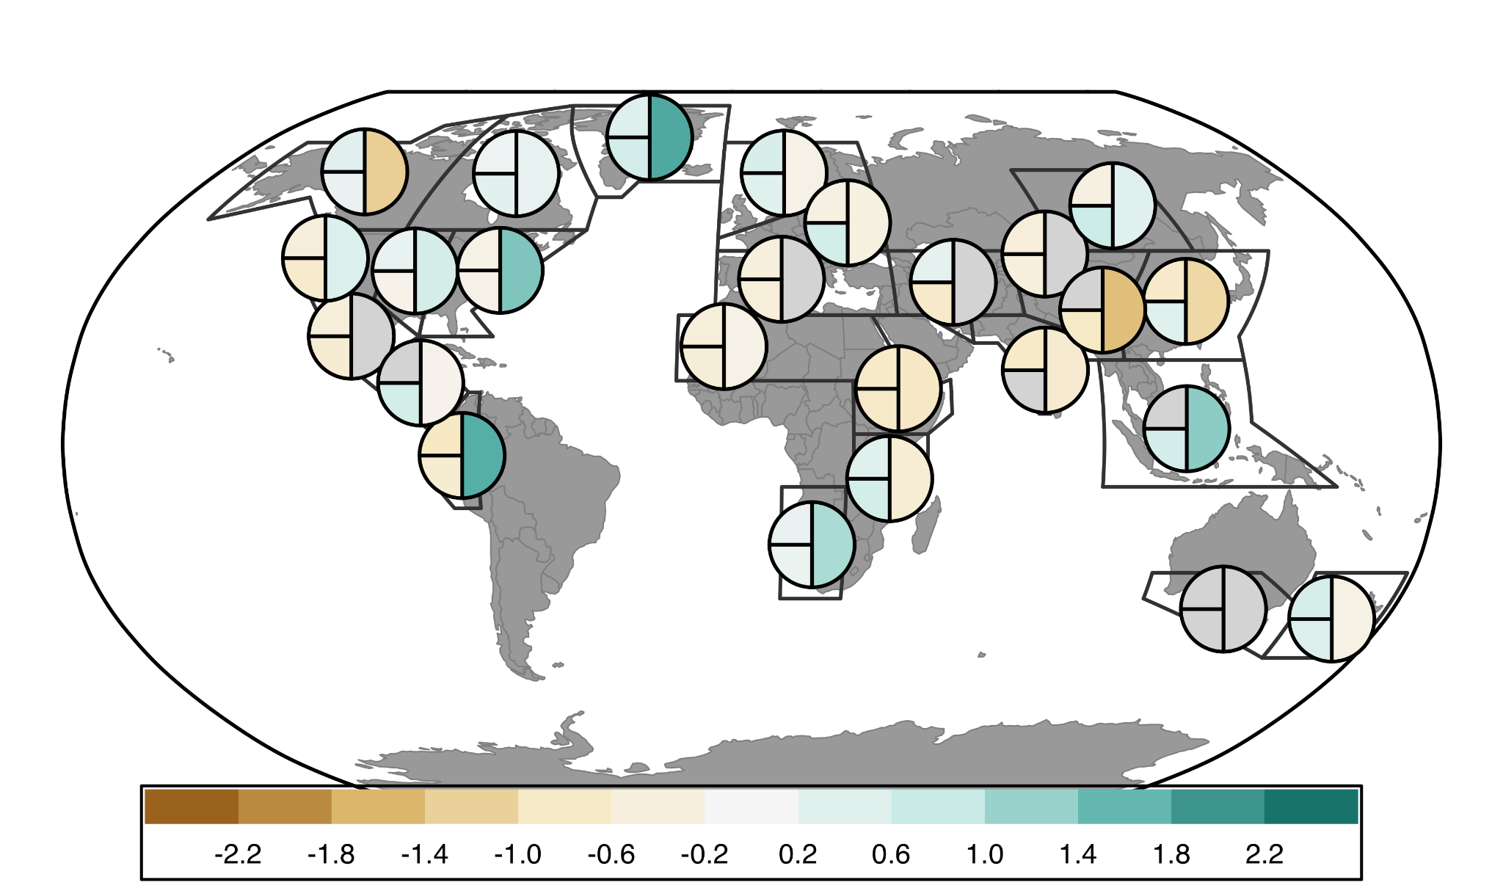
Comparison of Proxy and Model Slopes - FULL (12ka-0ka)
H
P
T

Slide 41
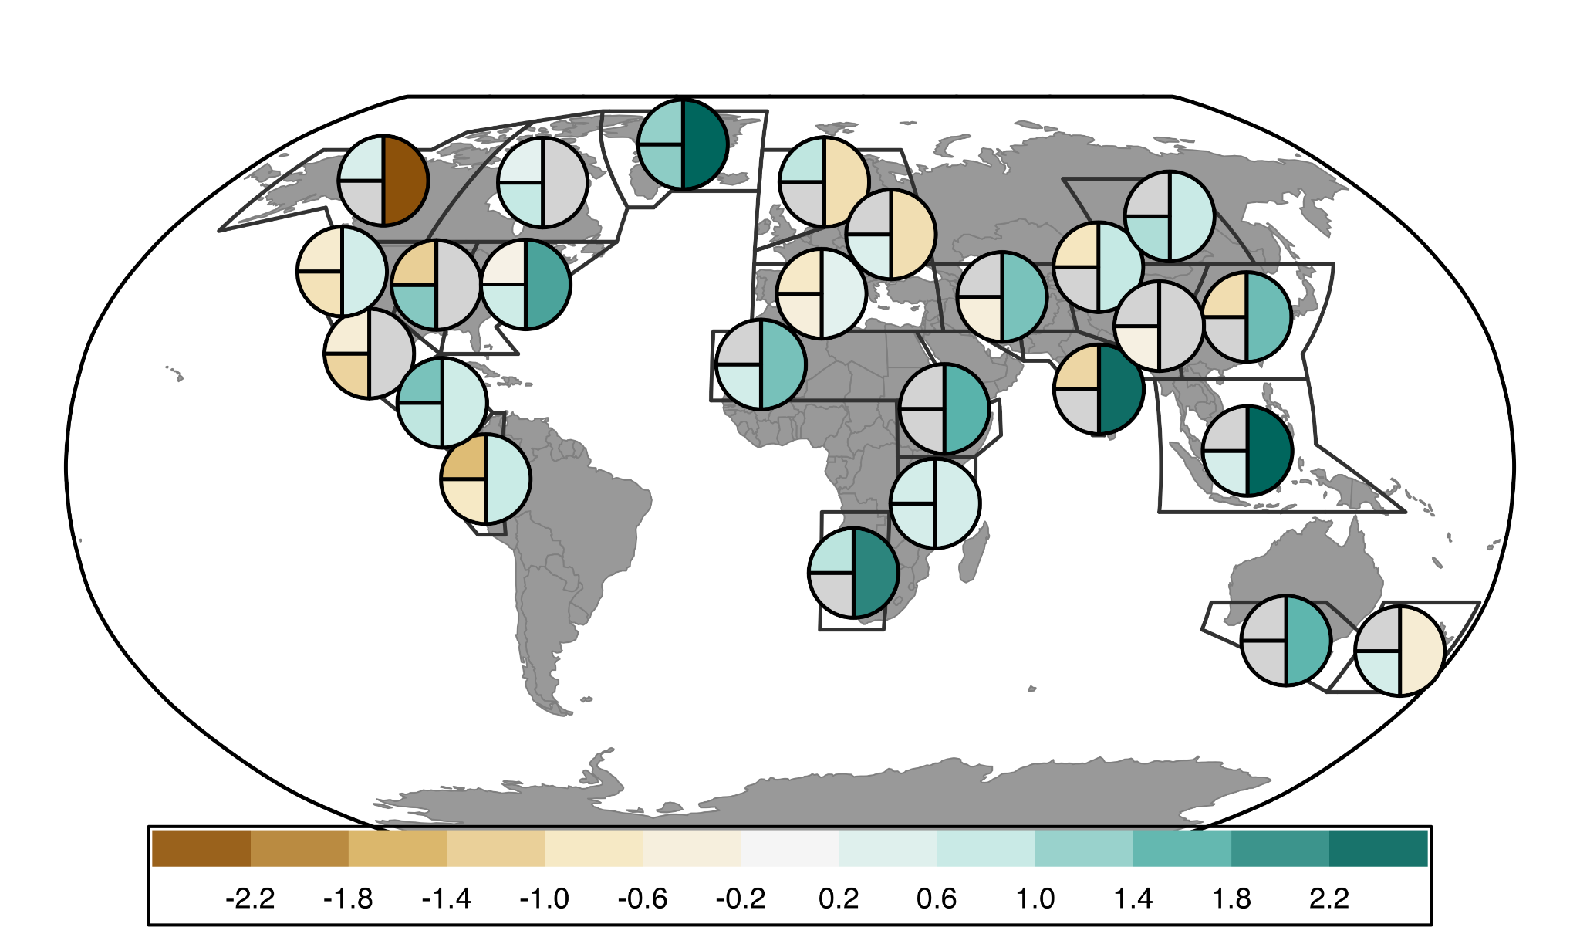
Comparison of Proxy and Model Slopes - EARLY (12ka-6ka)
H
P
T

Slide 42
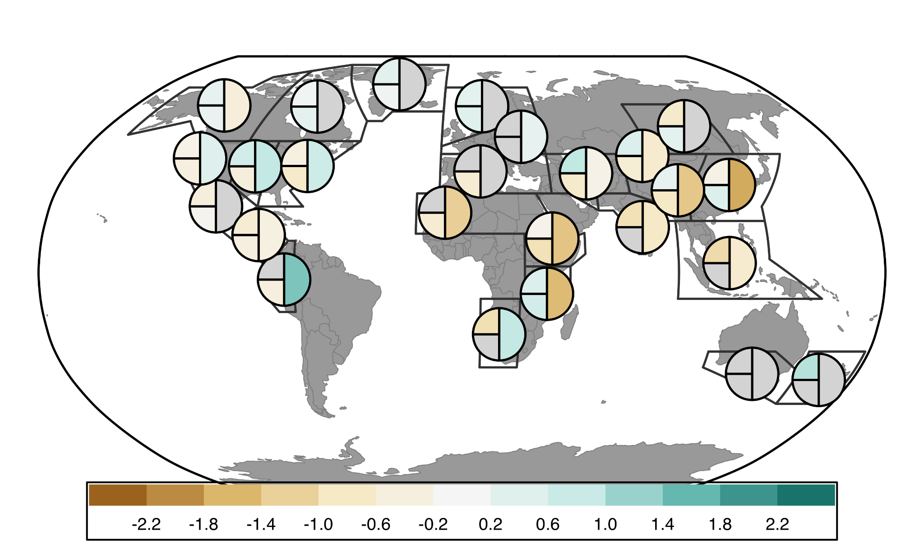
Comparison of Proxy and Model Slopes - LATE (6ka-0ka)
H
P
T

Slide 43
Wetting Stripes (1ka bins)

Slide 44
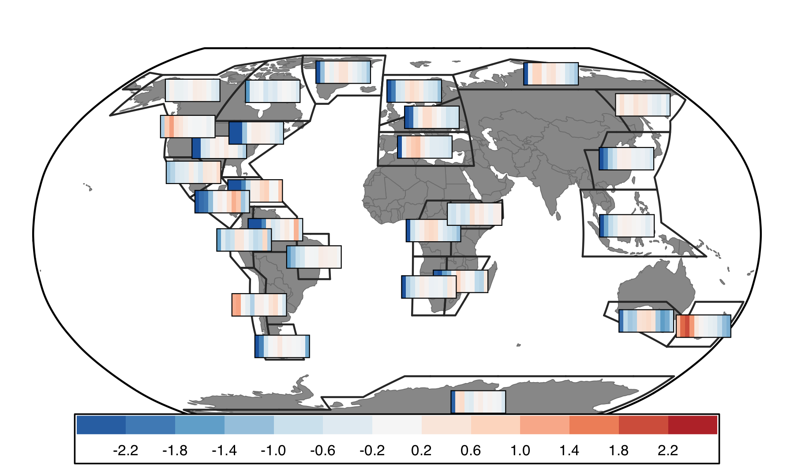
Warming Stripes (1ka bins)

Slide 45
Next Steps:
Decide what I want to say
Proxy-model agreement == model-model agreement
Do regions with agreement reflect more signal (greater magnitude changes
Monsoon signal more widespread in proxy data than models
Similar agreement with late Holocene Temperature?\

Slide 46
Next Steps:
Always more metadata to add/standardize (publication)
Write manuscript
Data Assimilation

Slide 48
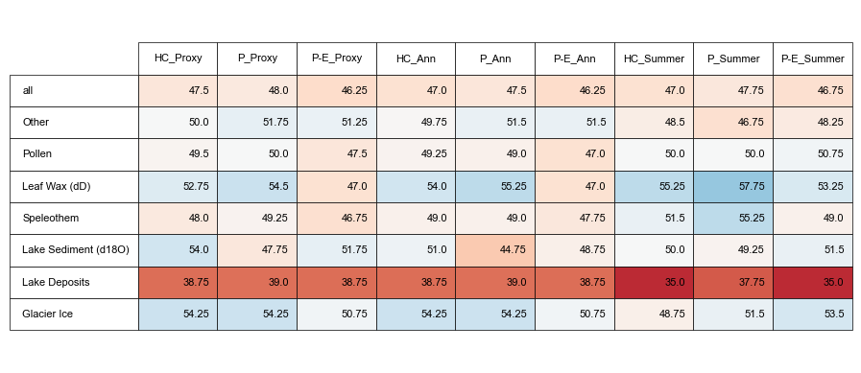

Notes:
Comparisons of how proxies (hydroclimate) compare with model pseudoproxies based on various assumptions about proxy climate interpretation (proxy metadata vs all P vs all P-E) and seasonality (proxy metadata vs assume annual are summer vs assume all are summer)
Top: Absolute %
Bottom: Difference between assumption test and using proxy metadata for both assumptions (1st column)

Slide 49


Slide 50


Slide 51


Slide 52

Figure 3: Cluster results
Notes:
R2 values: check from arcgis output

Slide 53

temperature
Notes:
Colors based on HC cluster # so will change to better distinguish neighboring clusters (pacific South America and Antarctica / 2 in Australasia)

